Slide 1
Loma Rica/Browns Valley Community Meeting
Fire Behavior

Slide 2
Assumptions
Weather
Mid August
Temp 89-94
Humidity 8- 18%
Winds

Slide 3
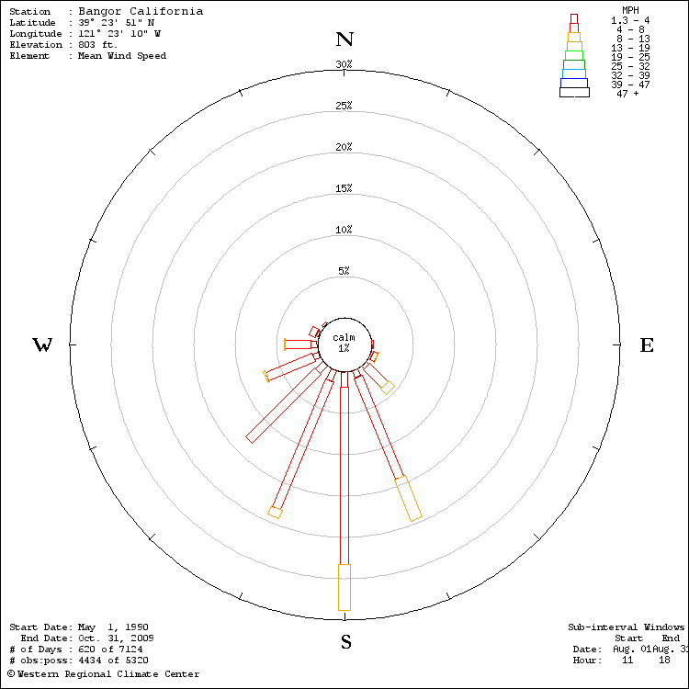
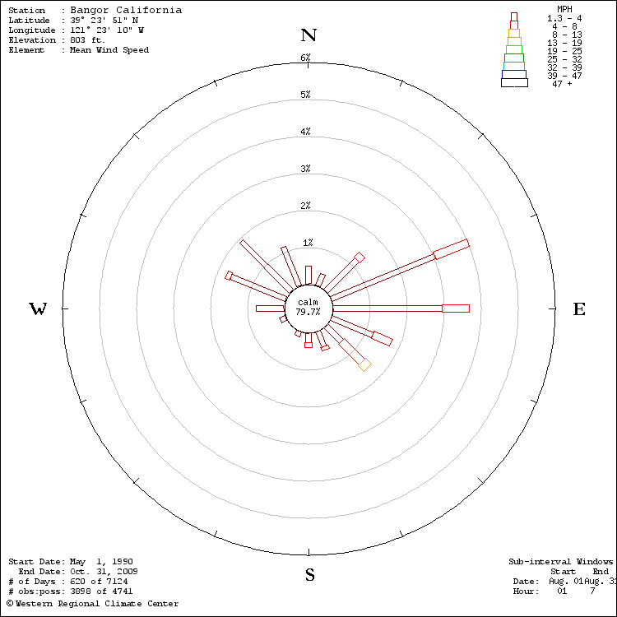

Slide 4
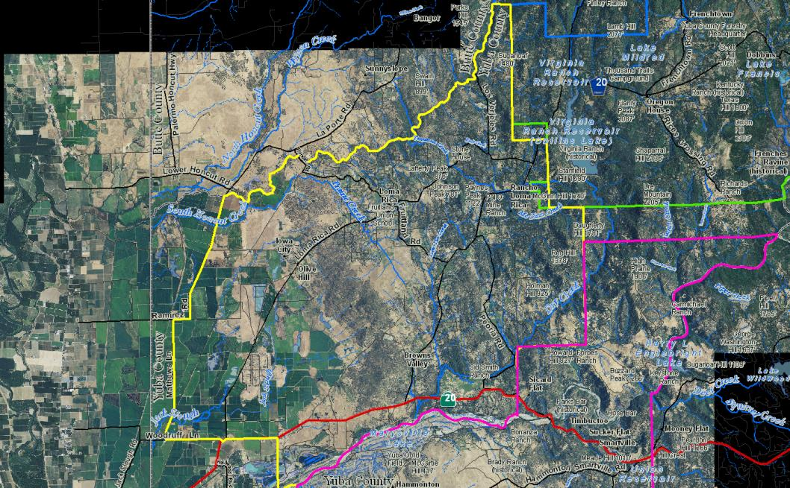

Slide 5
Fire Behavior Modeling

Slide 6
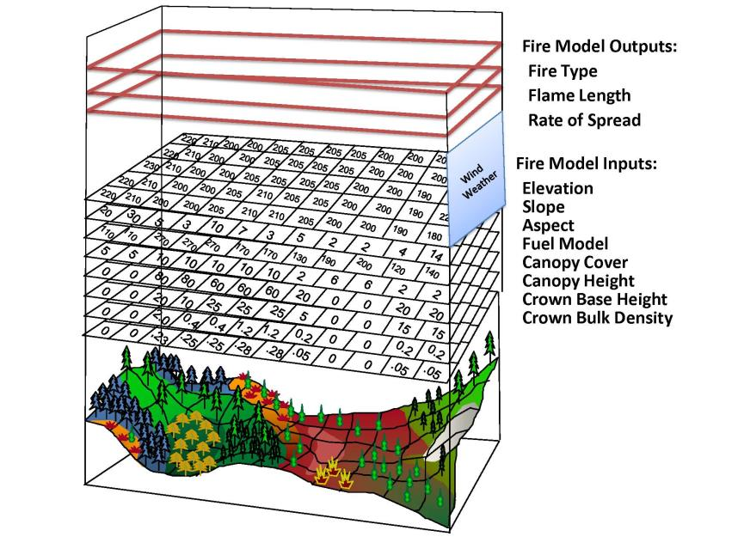

Slide 7
FLAMMAP

Slide 12
FARSITE

