Slide 1
Foothill Fire Protection District Community Meeting
Fire Behavior

Slide 2
Assumptions
Weather
Mid August
Temp 89-94
Humidity 8- 18%
Winds

Slide 3
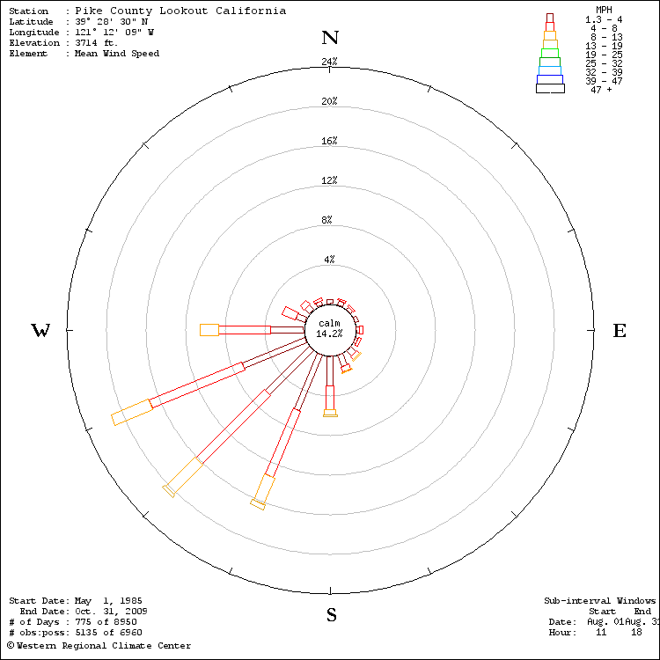
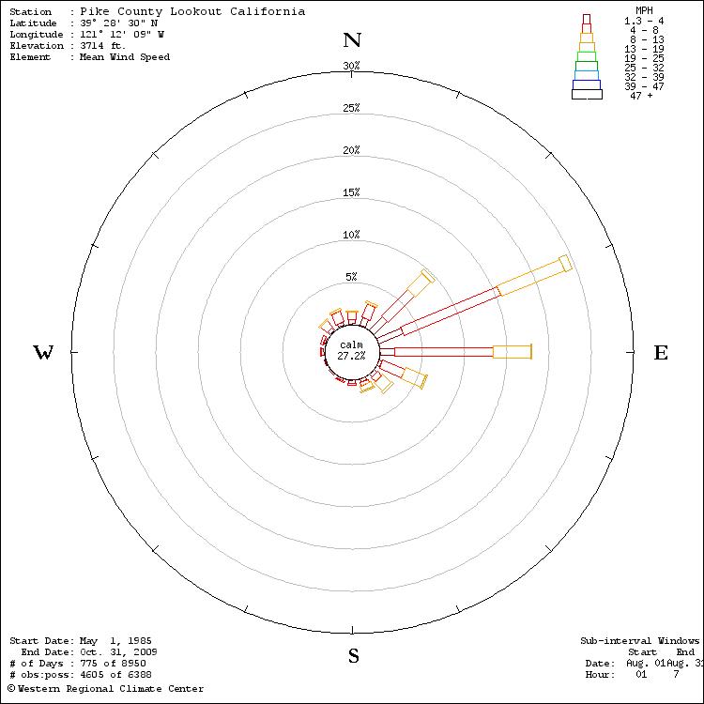

Slide 5
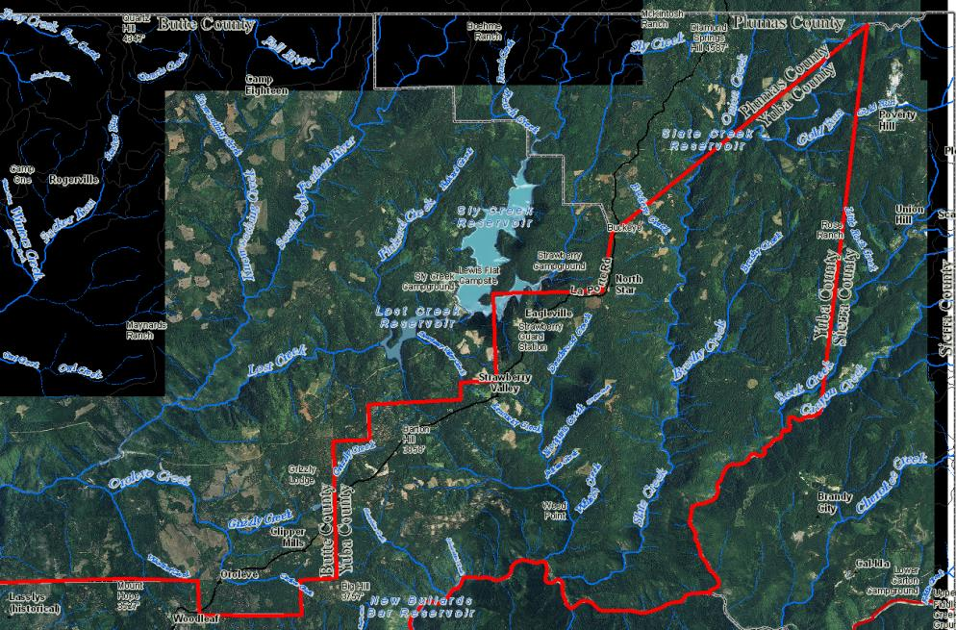

Slide 6
Fire Behavior Modeling

Slide 7
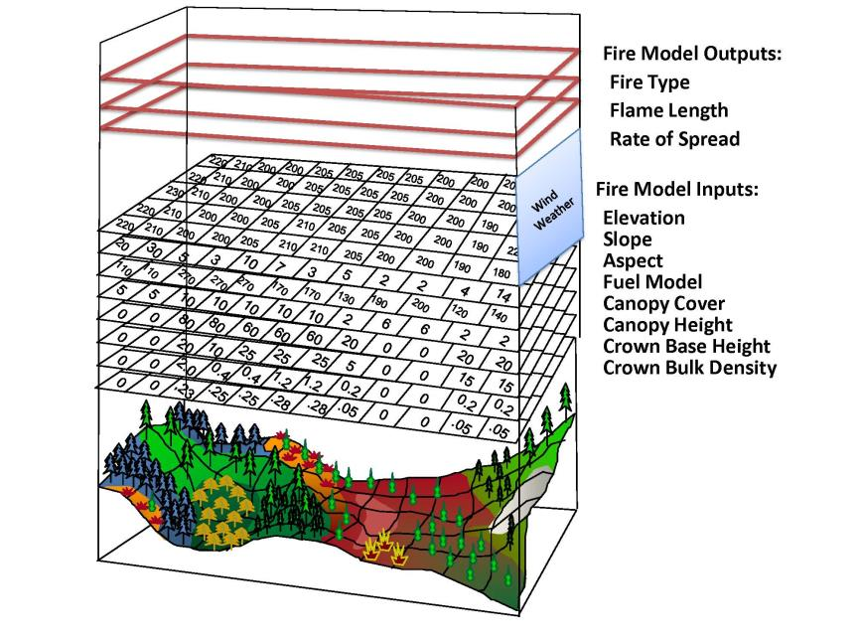

Slide 8
FLAMMAP

Slide 16
FARSITE

